Slide 1
Course Title: Advanced Finite Element Method and Finite Difference Method in Geotechnical Engineering
Course Code: CENG 8203
Credit Hours: 3
Program: Regular
Semester: I
Course Instructor: Dr. Tensay G.
University: Addis Ababa Science and Technology

Slide 2
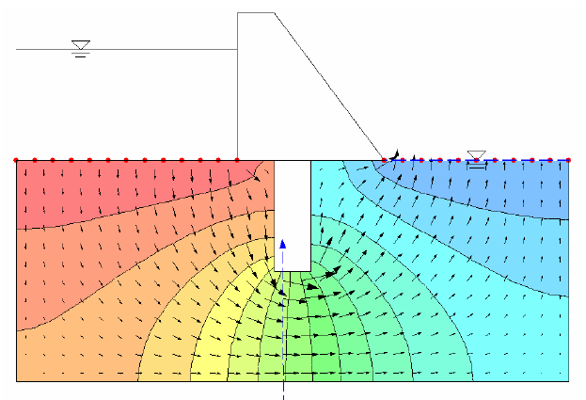
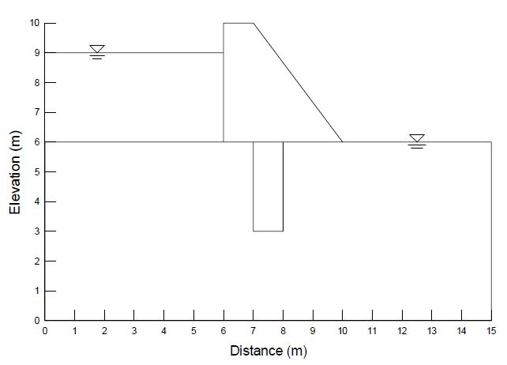
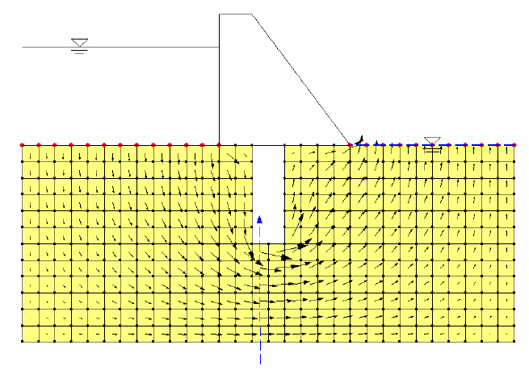
General of FE programs
11/30/2012

Slide 3
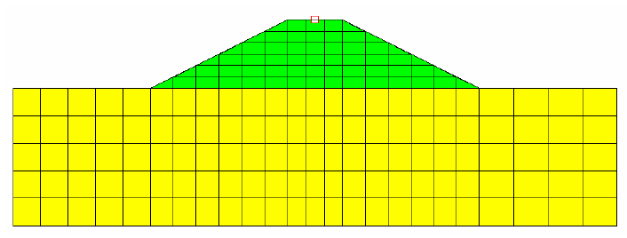
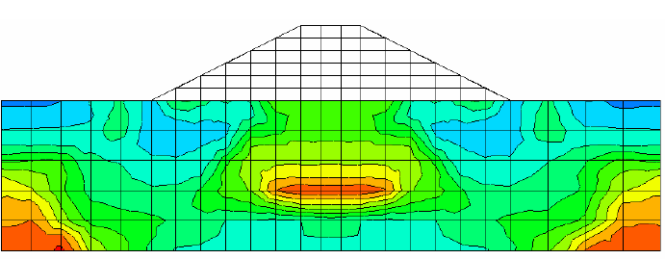
General Overview

Slide 4
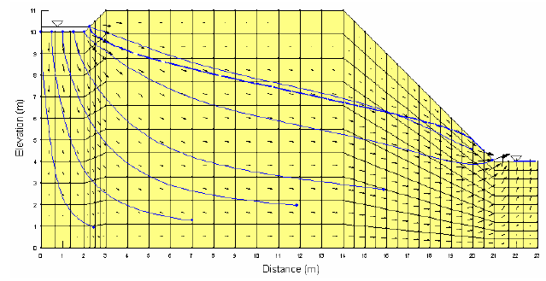
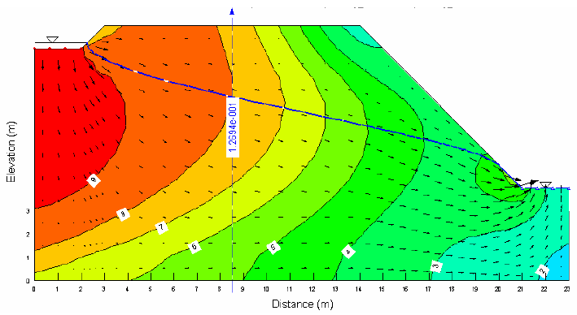
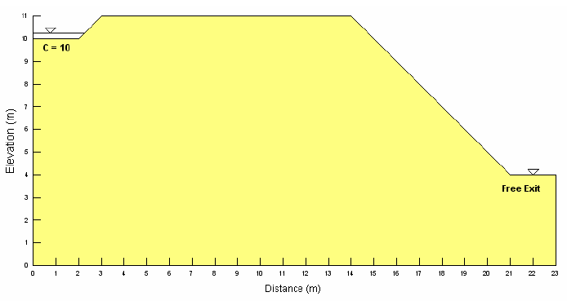
General Overview

Slide 5
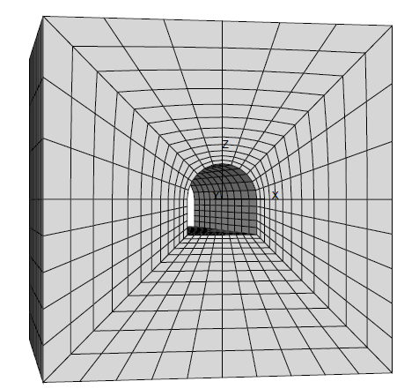
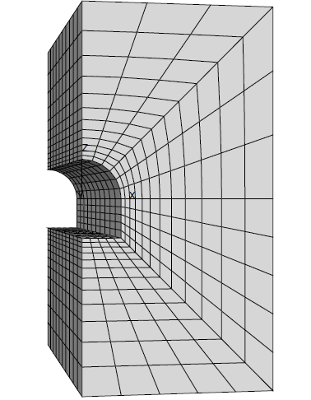
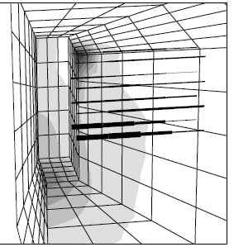
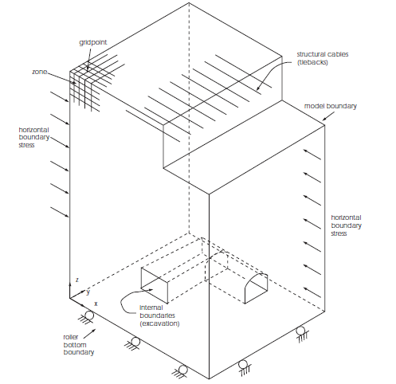
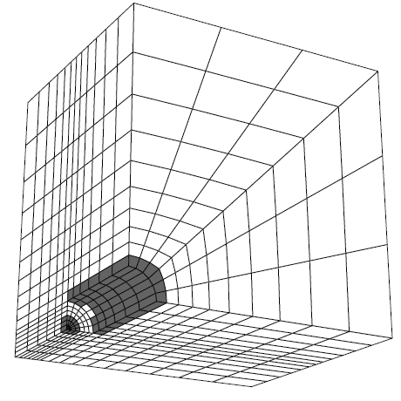
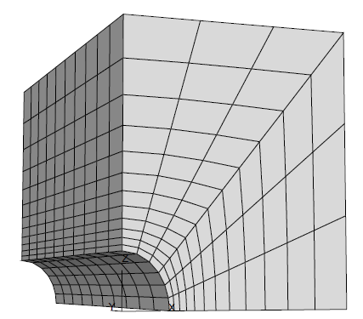
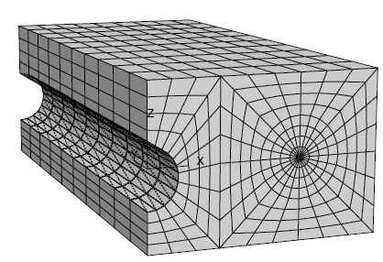
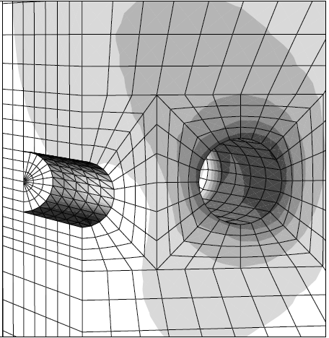
General Overview

Slide 6
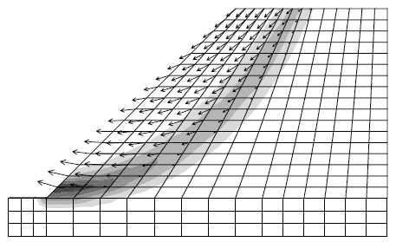
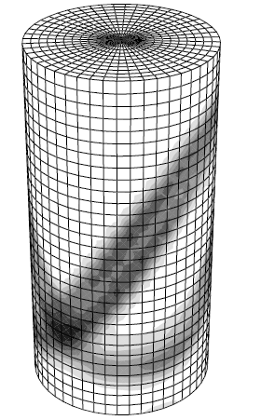
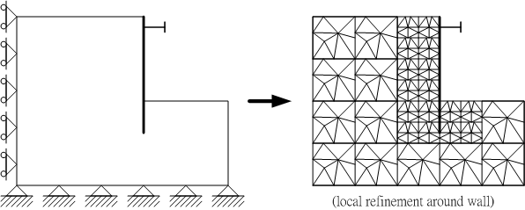

Slide 7
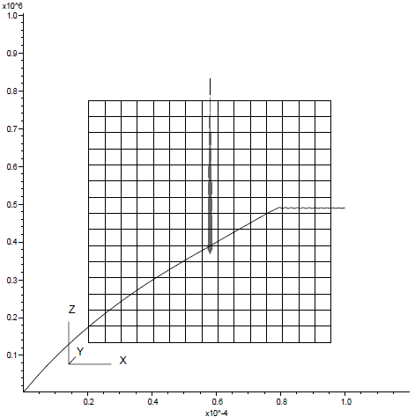

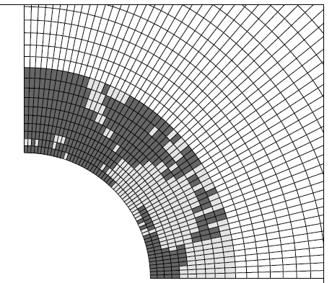
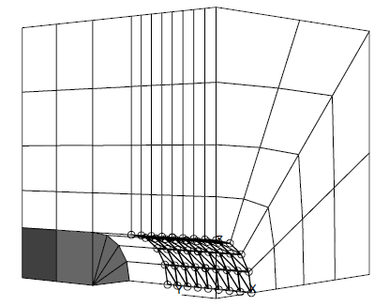
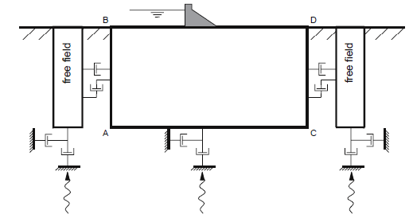

Slide 8
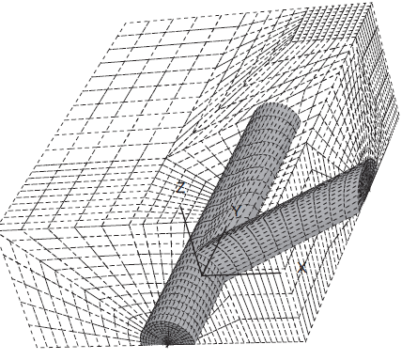
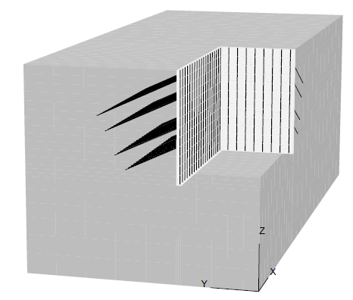
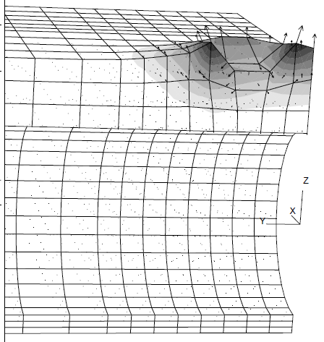
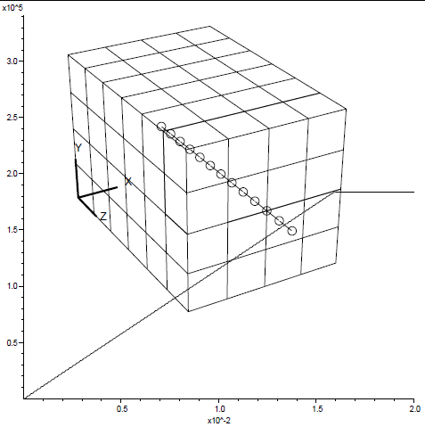
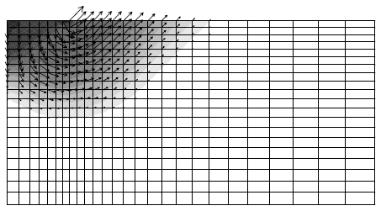

Slide 9
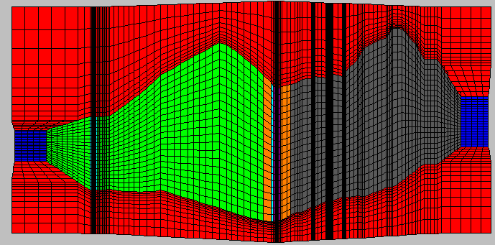
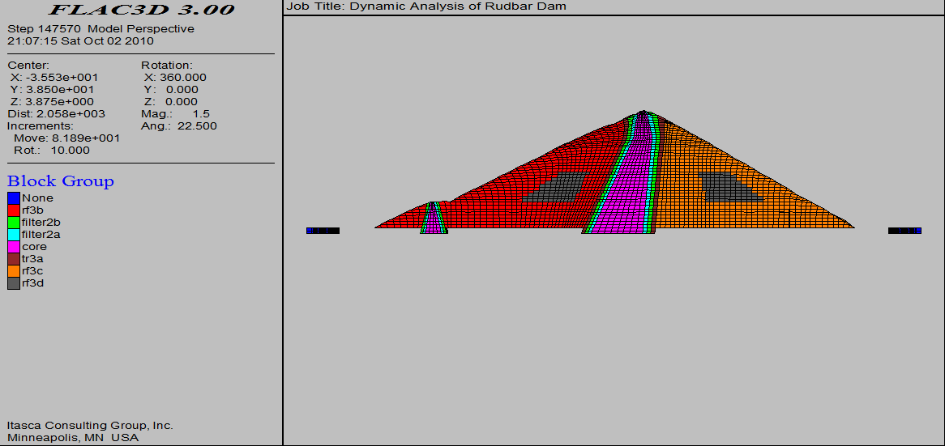
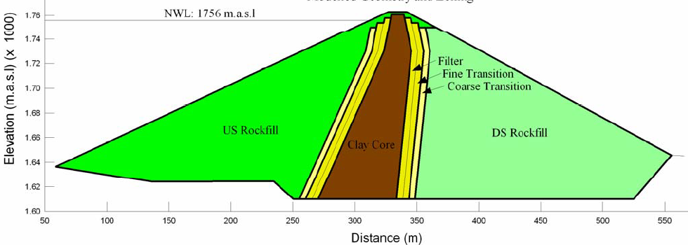
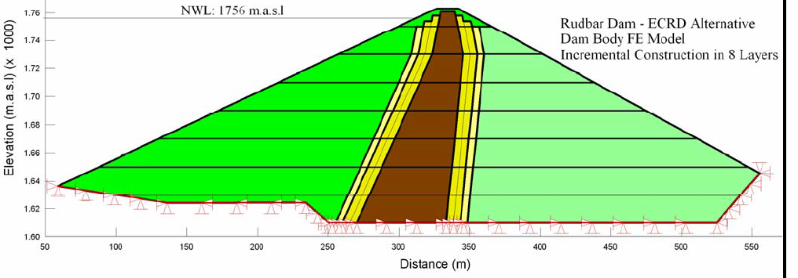
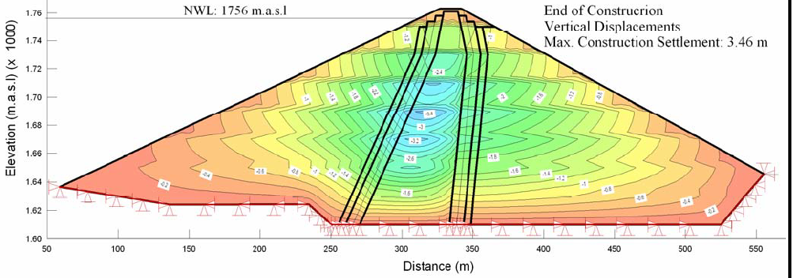

Slide 10
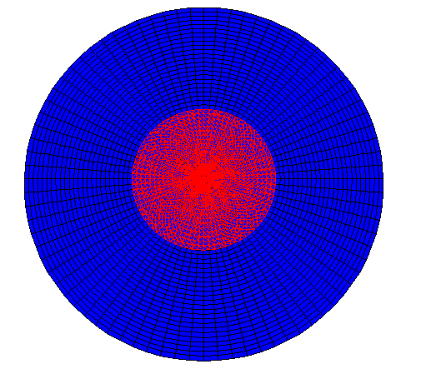

Slide 11
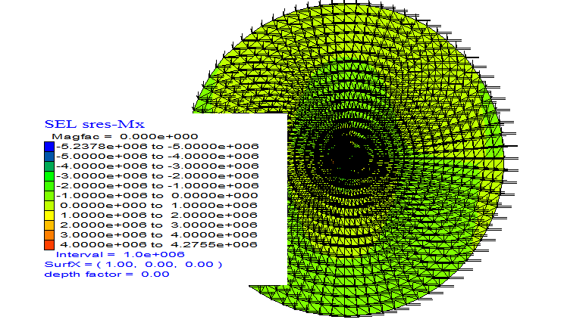
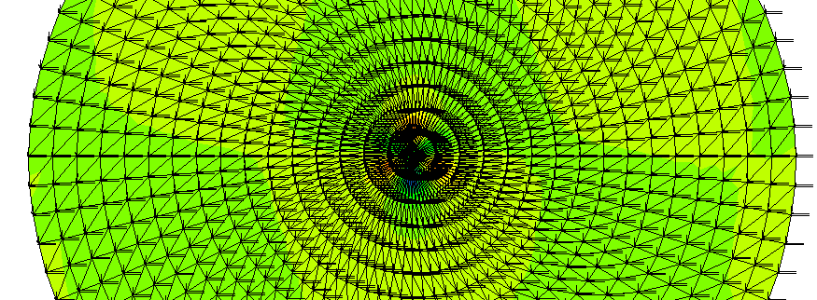

Slide 12
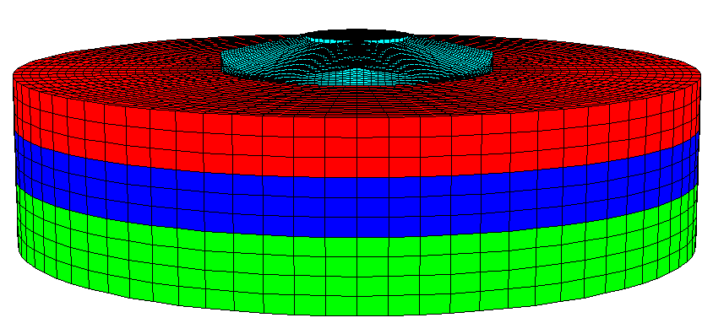

Slide 13
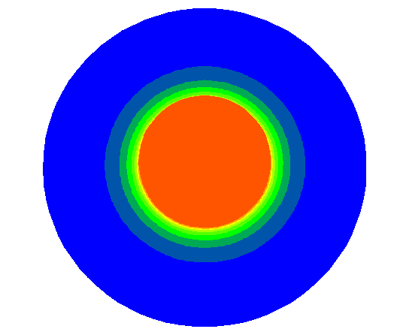
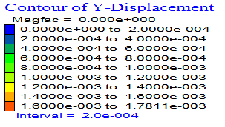

Slide 14
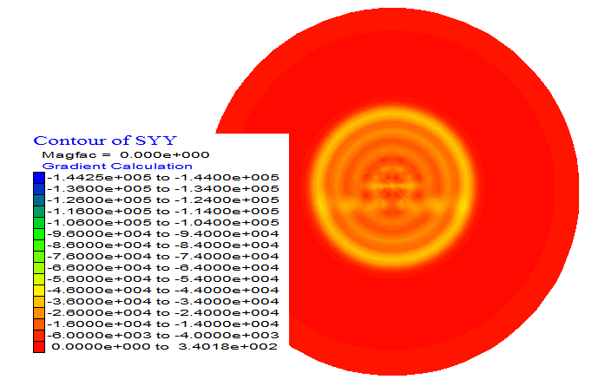

Slide 15


Slide 16
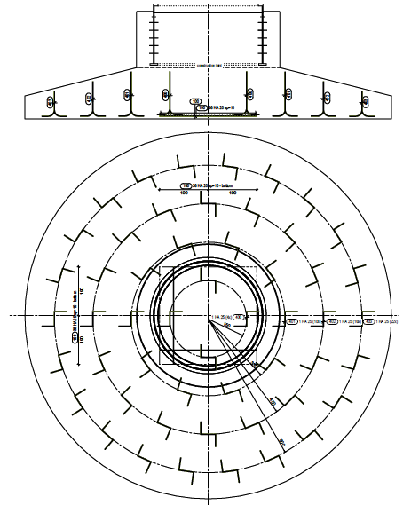
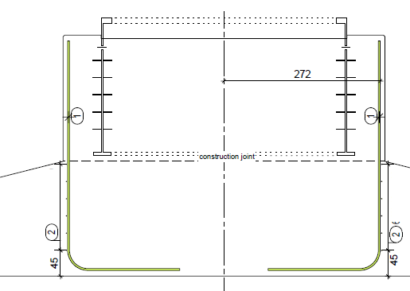

Slide 17
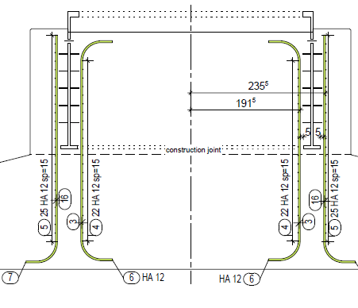
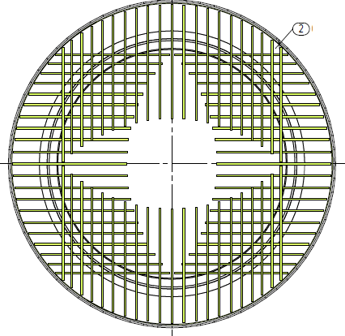
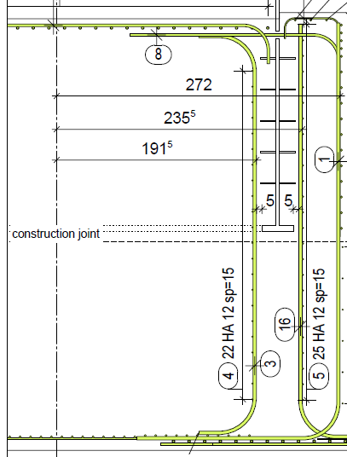
II - WTG FOUNDATION DESIGN AND CONSTRUCTION

Slide 18
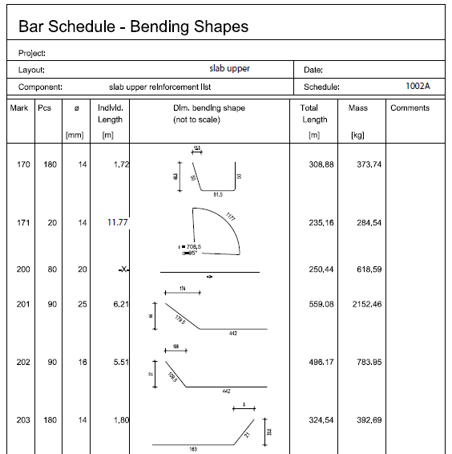

Slide 19
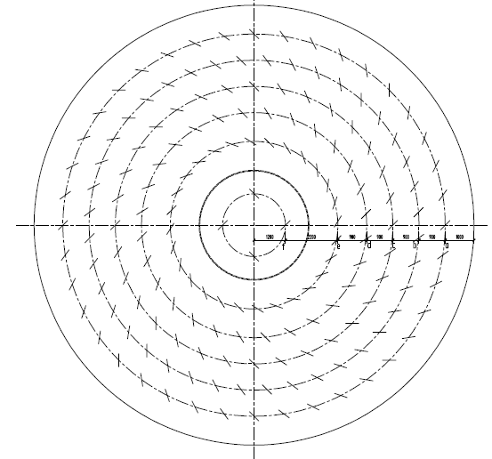
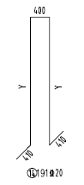

Slide 20
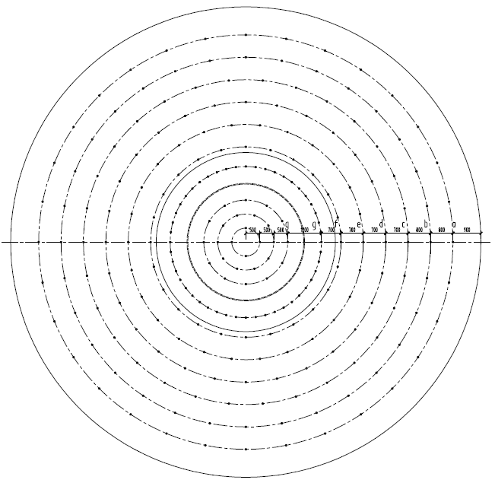
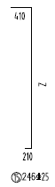

Slide 21
1.* Introduction to MATLAB
MATLAB is an interactive, matrix-based system for scientific and engineering numeric computation and visualization.
You can solve complex numerical problems in a fraction of the time required with a programming language such as Fortran or C.
The name MATLAB is derived from MATrix LABoratory.
Accessing MATLAB.
On most systems, after logging in one can enter MATLAB with the system command matlab and exit MATLAB with the MATLAB command quit or exit.

Slide 22
1.* Introduction to MATLAB ... Cont‘d
Entering matrices
MATLAB works with essentially only one kind of object;
a rectangular numerical matrix with possibly complex entries
all variables represent matrices.
In some situations, 1-by-1 matrices are interpreted as scalars and matrices with only one row or one column are interpreted as vectors.

Slide 23
1.* Introduction to MATLAB ... Cont‘d
Matrices can be introduced into MATLAB in several different ways:
Entered by an explicit list of elements,
Generated by built-in statements and functions,
Loaded from external data files or applications
Elements separators may be commas as well as a blank space.
Caution is required when listing a number in exponential form. (e.g. 2.34e-9)

Slide 24
1.* Introduction to MATLAB ... Cont‘d
MATLAB allows complex numbers in all its operations and functions.
Complex numbers can be entered in a convenient way as:
B = [1+5i 2+6i;3+7i 4+8i]
When listing complex numbers (e.g. 2+6i) in a matrix, blank spaces must be avoided.
Either i or j may be used as the imaginary unit. If, however, you use i and j as variables and overwrite their values, you may generate a new imaginary unit.
Matrices can also be generated with a for-loop

Slide 25
1.* Introduction to MATLAB ... Cont‘d
Matrices can also be generated with a for-loop
Individual matrix and vector entries can be referenced with indices inside parentheses in the usual manner.
For example, A(2, 3) denotes the entry in the second row, third column of matrix A and x(3) denotes the third coordinate of vector x. Try it.
A matrix or a vector will only accept positive integers as indices.

Slide 26
1.* Introduction to MATLAB ... Cont‘d
Matrix /Array operations
The following matrix operations are available in MATLAB:
+ addition
- subtraction
* multiplication
^ power
‘ conjugate transpose
\ left division
/ right division
These matrix operations apply, of course, to scalars (1-by-1 matrices) as well.
If the sizes of the matrices are incompatible for the matrix operation, an error message will result

Slide 27
1.* Introduction to MATLAB ... Cont‘d
The " matrix division" operations deserve special comment.
If A is an invertible square matrix and b is a compatible column, resp. row, vector, then x = A/b is the solution of A*x = b and, resp., x = b\A is the solution of x * A = b.
Array operations.
The matrix operations of addition and subtraction already operate entry-wise but …
It is important to observe that the other operations, *, ^, /, and \, can be made to operate entry-wise by preceding them by a period.
For example, either [1,2,3,4].*[1,2,3,4] or [1,2,3,4].^ 2 will...

Slide 28
1.* Introduction to MATLAB ... Cont‘d
Statements, expressions, and variables
MATLAB is an expression language; the expressions you type are interpreted and evaluated.
MATLAB statements are usually of the form:
variable = expression, or simply
expression
Expressions are usually composed from operators, functions, and variable names.
Evaluation of the expression produces a matrix, which is then displayed on the screen and assigned to the variable for future use.

Slide 29
1.* Introduction to MATLAB ... Cont‘d
If the variable name and = sign are omitted, …
Several statements can be placed on a single line if separated by commas or semicolons.
If the last character of a statement is a semicolon, the printing is suppressed, but the assignment is carried out.
This is essential in suppressing unwanted printing of intermediate results.

Slide 30
1.* Introduction to MATLAB ... Cont‘d
MATLAB is case-sensitive in the names of commands, functions, and variables.
List of variables currently in the workspace can be… who (or whos).
A variable can be cleared from the workspace with the command clear variablename. The command clear alone will clear all nonpermanent variables.
The permanent variable eps (epsilon) gives the machine unit round-off about 10E-16 on most machines. (for convergence)
A runaway display or computation can be stopped...

Slide 31
1.* Introduction to MATLAB ... Cont‘d
Matrix building functions
Some important convenient matrix building functions are:
eye - identity matrix
zeros - matrix of zeros
eig – eigenvlaues of a matrix
[C,D] eig(A)-
ones - matrix of ones
diag - create or extract diagonals
triu - upper triangular part of a matrix
tril - lower triangular part of a matrix

Slide 32
1.* Introduction to MATLAB ... Cont‘d
For example, zeros(m,n) produces an m-by-n matrix of zeros
zeros(n) produces an n-by-n one.
If A is a matrix, then zeros(size(A)) produces a matrix of zeros having the same size as A.
If x is a vector, diag(x) is the diagonal matrix with x down the diagonal
If A is a square matrix, then diag(A) is a vector consisting of the diagonal of A. What is diag(diag(A))? Try it.

Slide 33
1.* Introduction to MATLAB ... Cont‘d
Matrices can be built from blocks.
For example, if A is a 3-by-3 matrix, then B = [A, zeros(3,2); zeros(2,3), eye(2)] will build .... Try it.
For, while, if - and relations.
In their basic forms, these MATLAB flow control statements operate like those in most computer languages.
For
For example, for a given n, the statement
x = [ ]; for i = 1:n, x=[x,i^2], end
Or
x = [ ];
for i = 1:n
x = [x,i^2]
end

Slide 34
1.* Introduction to MATLAB ... Cont‘d
The statements
for i = 1:m
for j = 1:n
H(i, j) = 1/(i+j-1);
end
end
H
The semicolon on the inner statement … unwanted intermediate results while the last H displays the final result.
s = 0;
for d = A
s = s + sum(d);
end

Slide 35
1.* Introduction to MATLAB ... Cont‘d
While
The general form of a while loop is
While relation
statements
End
The statements will be repeatedly executed as long as the relation remains true. 2^{n} >= a … :
n = 0;
while 2^n < a
n = n + 1;
end
n

Slide 36
1.* Introduction to MATLAB ... Cont‘d
If
The general form of a simple if statement is
if relation
statements
end
Multiple branching is also possible, as is illustrated by
if n < 0
number = ‘Negtive’;
elseif rem(n,2) == 0
number = ‘Even positive’;
else
number = ‘Odd Positive’;
end

Slide 37
1.* Introduction to MATLAB ... Cont‘d
Relations.
The relational operators in MATLAB are
< less than
> greater than
<= less than or equal
>= greater than or equal
== equal
~= not equal.
Note that ‘’=" is used in an assignment statement while ‘’==" is used in a relation.
Relations may be connected or quantified by the logical operators
& and
| or
~ not.

Slide 38
1.* Introduction to MATLAB ... Cont‘d
Scalar functions.
Certain MATLAB functions operate essentially on scalars, but operate element-wise when applied to a matrix.
The most common such functions are:
sin asin exp abs round
cos acos log (natural log) sqrt floor
tan atan rem (remainder) sign ceil
Vector functions.
A few of these functions are:
max sum median any
Min prod mean all
sort std

Slide 39
1.* Introduction to MATLAB ... Cont‘d
Matrix functions.
Much of MATLAB's power comes from its matrix functions. The most useful ones are:
eig eigenvalues and eigenvectors
chol cholesky factorization
inv inverse
lu LU factorization
expm matrix exponential
sqrtm matrix square root
poly characteristic polynomial
det determinant
size size
rank rank

Slide 40
1.* Introduction to MATLAB ... Cont‘d
MATLAB functions may have single or multiple output arguments. For example,
y = eig(A), or simply eig(A)
produces a column vector containing the eigenvalues of A while
[U,D] = eig(A)
produces a matrix U whose columns are the eigenvectors of A and a diagonal matrix D with the eigenvalues of A on its diagonal. Try it.
Submatrices and colon notation.
Vectors and submatrices are often used in MATLAB to achieve fairly complex data manipulation effects.

Slide 41
1.* Introduction to MATLAB ... Cont‘d
Colon notation:
used both to generate vectors and reference submatrices.
Creative use of these features to vectorize operations permits one to minimize the use of loops (which slows MATLAB) and to make code simple and readable.
The expression 1:5 (met earlier in for statements) is actually the row vector [1 2 3 4 5].

Slide 42
1.* Introduction to MATLAB ... Cont‘d
The numbers need not be integers nor the increment one.
For example, 0.2:0.2:1.2 gives [0.2, 0.4, 0.6, 0.8, 1.0, 1.2], & 5:-1:1 gives [5 4 3 2 1].
The following statements will, for example, generate a table of sines. Try it.
x = [0.0:0.1:2.0]’;
y = sin(x);
[x y]

Slide 43
1.* Introduction to MATLAB ... Cont‘d
The colon notation can be used to access submatrices of a matrix. For example, A(1:4,3) is the column vector consisting of the first four entries of the third column of A.
A colon by itself denotes an entire row or column:
A(:,3) is the third column of A, and A(1:4,:) is the first four rows.
Arbitrary integral vectors can be used as subscripts:
A(:,[2 4]) contains as columns, columns 2 and 4 of A.
Such subscripting can be used on both sides of an assignment statement:
A(:,[2 4 5]) = B(:,1:3) replaces columns 2,4,5 of A with the first three columns of B.

Slide 44
1.* Introduction to MATLAB ... Cont‘d
M-files.
MATLAB can execute a sequence of statements stored in diskfiles.
Such files are called M-files" because they must have the file type of .m as the last part of their filename.
Much of your work with MATLAB will be in creating and refining M-files. M-files are usually created using your local editor.
There are two types of M-files: script files and function files.

Slide 45
1.* Introduction to MATLAB ... Cont‘d
Graphics.
MATLAB can produce planar plots of curves, 3-D plots of curves & 3-D mesh, surface plots.
The primary commands for these facilities are plot , plot3, mesh, and surf resp.
Planar plots:#,
The plot command creates linear x-y plots; if x and y are vectors of the same length, the command plot(x,y) opens a graphics window and draws an x-y plot of the elements of x versus the elements of y.
One can draw the graph of the sine function over the interval -4 to 4 with the following commands:
x = -4:.01:4; y = sin(x); plot(x,y) Try it.

Slide 46
1.* Introduction to MATLAB ... Cont‘d
Linetypes: solid (-), dashed (--). dotted (:), dashdot (-.)
Marktypes: point (.), plus (+), star (*), circle (o), x-mark (x)
Colors can be specified for the line- and mark-types.
Colors: yellow (y), magenta (m), cyan (c), red (r), green (g), blue (b), white (w), black (k)
For example:
x = -1.5:.01:1.5; y = exp(-x.^2); plot(x,y, 'r--')

Slide 47

1.2 Computational Mechanics

Slide 48

1.2 Computational Mechanics…

Slide 49


1.2 Computational Mechanics…

Slide 50


1.2 Computational Mechanics…

Slide 51

2.1.1 FEM Variants
2 FINITE ELEMENT METHOD
2.1 Introduction to Finite Element Method

Slide 52


Slide 53


Slide 54

2.1.2 FEM Analysis Process

Slide 55

2.1.3 Interpretations of FEM

Slide 56


Slide 57


Slide 58


Slide 59


Slide 60


2.2 1D Finite element
Types of Finite Elements

Slide 61

2.2 1D Finite element
2.2.1 Spring Element

Slide 62

2.2 1D Finite element

Slide 63


2.2 1D Finite element

Slide 64

2.2 1D Finite element

Slide 65

2.2 1D Finite element

Slide 66

2.2 1D Finite element

Slide 67

2.2 1D Finite element

Slide 68

2.2 1D Finite element

Slide 69


2.2 1D Finite element

Slide 70

2.2 1D Finite element

Slide 71

2.2 1D Finite element

Slide 72

2.2 1D Finite element

Slide 73


2.2 1D Finite element

Slide 74


2.2 1D Finite element

Slide 75

2.2 1D Finite element

Slide 76

2.2 1D Finite element

Slide 77

2.2 1D Finite element

Slide 78

2.2 1D Finite element

Slide 79
2.2 1D Finite element
Steps to be followed:
Step-1: discretizing the domain
Step-2: Writing the ESM
Step-3: Assembling the GSM
Step-4: Applying the BCs
Step-5: Solving the Eqns
Step-6: Post processing

Slide 80


2.2.2 Bar and Beam Element

Slide 81




Slide 82



Slide 83



Slide 84



Slide 85


Slide 86


Slide 87


Slide 88



Slide 89


Slide 90



Slide 91





Slide 92



Slide 93


Exercise:
Check your solution obtained above if the load P is reduced by half

Slide 94


2.3 2D Finite Element

Slide 95

2.3 2D Finite Element

Slide 96

2.3 2D Finite Element

Slide 97

2.3 2D Finite Element

Slide 98

2.3 2D Finite Element

Slide 99

2.3 2D Finite Element

Slide 100

2.3 2D Finite Element

Slide 101


2.3 2D Finite Element

Slide 102

2.3 2D Finite Element

Slide 103


2.3 2D Finite Element

Slide 104

2.3 2D Finite Element
What if, there is a hole inside?

Slide 105


2.3 2D Finite Element

Slide 106

2.3 2D Finite Element

Slide 107

2.3 2D Finite Element

Slide 108

2.3 2D Finite Element

Slide 109

2.3 2D Finite Element

Slide 110


2.3 2D Finite Element

Slide 111


2.3 2D Finite Element

Slide 112


2.3 2D Finite Element

Slide 113

2.3 2D Finite Element

Slide 114


2.3 2D Finite Element
Natural Coordinate

Slide 115

2.3 2D Finite Element

Slide 116

2.3 2D Finite Element

Slide 117

2.3 2D Finite Element

Slide 118

2.3 2D Finite Element

Slide 119

2.3 2D Finite Element

Slide 120

2.3 2D Finite Element

Slide 121

2.3 2D Finite Element

Slide 122

2.3 2D Finite Element

Slide 123


2.3 2D Finite Element

Slide 124

2.3 2D Finite Element

Slide 125




Slide 126



Slide 127


Slide 128

Example:
Step-1: Discritize the Domain
Step-2: Develop ESM

Slide 129


Slide 130

Step-3: Assembling the GSM
The problem has 4 nodes and hence 8 dof (8x8 matrix)

Slide 131


Slide 132



Step-4: Apply BC (Refer to paper)
Step-5: Solve (thru partitioning)

Slide 133





Step-6: Post-processing

Slide 134



Slide 135

Principal stresses and angle

Slide 136


Slide 137


Slide 138

Bilinear Quadrilateral Element

Slide 139


Slide 140


Slide 141


Slide 142


Slide 143


Slide 144


Slide 145


Linear Tetrahedral (solid) Element

Slide 146


Slide 147


Slide 148


Slide 149


Slide 150



